Slide 1
Can economic policies keep Japan from sinking?; A pessimist’s view of the future of the Japanese economy
Masahiko Takeda
Asian Public Policy Program
Hitotsubashi University
December 9, 2016

Slide 2
The theme of my presentation !

Slide 3
Before Abenomics
Prior to the introduction of Abenomics in 2013, the Japanese economy was said to be suffering from a six-fold handicap, which was seen to be the source of its stagnation. Namely,
Appreciated yen
High corporate income tax rate
Delay in TPP participation
Strict labor regulations
Cost of CO₂ emission reduction
Shortage and high cost of electricity
Have these been addressed under Abenomics? To what extent?

Slide 4
Scorecard
Some notable progress, e.g. the exchange rate, TPP, and the CIT rate.
Only 3 out of 57 nuclear power plants are currently in operation. Yet, this has not seriously affected the economy.
Labor market reform is slow to move forward, but efforts are being made.
The economy has been broadly in good shape. Labor market is tight, though wages are not rising. The inflation target has been elusive.
Notes:
CIT; currently no.7 (29.74%), but was no.2 until recently. Korea no.19 (24.2%).

Slide 5
GDP growth performance
Consumption tax
(5% ⇒ 8%)
Abenomics
Reconstruction from
3/11 earthquake

Slide 6
How is the recent growth performance being seen?
“Lacklaster”.
Consumption has been depressed since the tax hike, domestic investment has been subdued, and exports haven’t risen as expected. As a result, the second leg of consumption tax hike has been twice postponed.
But is economic growth of around 1% really disappointing? No, it isn’t.

Slide 7
The major headwind Japan is facing
Notes:
The cumulative change over 45 years (2015-60) is 42.5%.

Slide 8
Potential growth estimate (Bank of Japan)
(capital stock)
(worker headcount)
(hours worked)
(potential growth)

Slide 9
How serious is this problem?
Low GDP growth does not necessarily mean that Japanese cannot expect much from the future. Per capita income can grow while aggregate output and income are shrinking.
Then, can Japan become a smaller but individually-richer country and be content with that? No, because there are two major issues that stand in the way.
That is, population aging and public debt sustainability.

Slide 10
Old-age dependency ratio (National Institute of Population and Social Security Research, 2011)

Slide 11
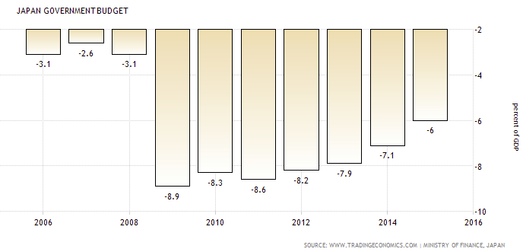
Japan’s excessive and unsustainable public debt

Slide 12
How to reduce D/Y
Four ways to reduce D/Y (Y = py)
Run budget surplus and pay back debt.
Achieve high growth and increase y.
Default on D.
Increase p and inflate the debt away.
Little political will for 1), and dim prospect for 2). The government cannot choose 3), so 4) increasingly appears to be the only choice …
BoJ’s QQE is consistent with this scenario. But ironically, inflation is not being generated !

Slide 13
How to interpret QQE
BoJ is being seen to have failed to achieve its target. But this may be a blessing in disguise.
If and when inflation picks up and exceeds 2%, BoJ will have to exit from QQE. Then, its massive support for JGB yields will stop. Will the government continue to be able to finance?
In spite of this concern, the government currently has no incentive to reduce budget deficits. It can issue debt at negative interest rates !

Slide 14
What needs to be done
Stop fiscalizing monetary policy.
No more procrastination of fiscal adjustment.
Implement the “growth strategy” at full speed to increase y.
The labor market is key. “Womanomics” and re-employment of retired workers help. But their contributions are way too small compared with the population headwind.
There seems to be no other way than substantially opening the labor market to foreign workers.

Slide 15
Conclusion
Current economic conditions are not bad relative to potential. But going forward, major challenges are sure to come.
There must be something special about Japan since its public debt has been able to become so large with no crisis. But it is unwise to push this luck too far.
Can economic policies keep Japan from sinking? Yes, but there is no sense of urgency because budget finance is so easy. Cannot help becoming pessimistic about the future …

Slide 16
Extra; Lessons for Korea?
Always assess economic performance relative to potential. Manage expectations of politicians and the public so that excessive burden is not placed on demand-side policies.
In particular, refrain from relying too much on fiscal stimulus for short-run gains of output and employment so as to avoid accumulation of public debt.
Focus on structural reform to strengthen potential growth.
Mindful of asset price increases under low inflation and low interest environment.

Slide 17
Thank you !

Slide 18
Masaaki Shirakawa, “Demographic Changes and Macroeconomic Performance: Japanese experiences” May 30, 2012

